Slide 1

Flame Extinction Using Sound Wave
Machine Learning Approach
Francisco Pinto - 89888

Slide 2
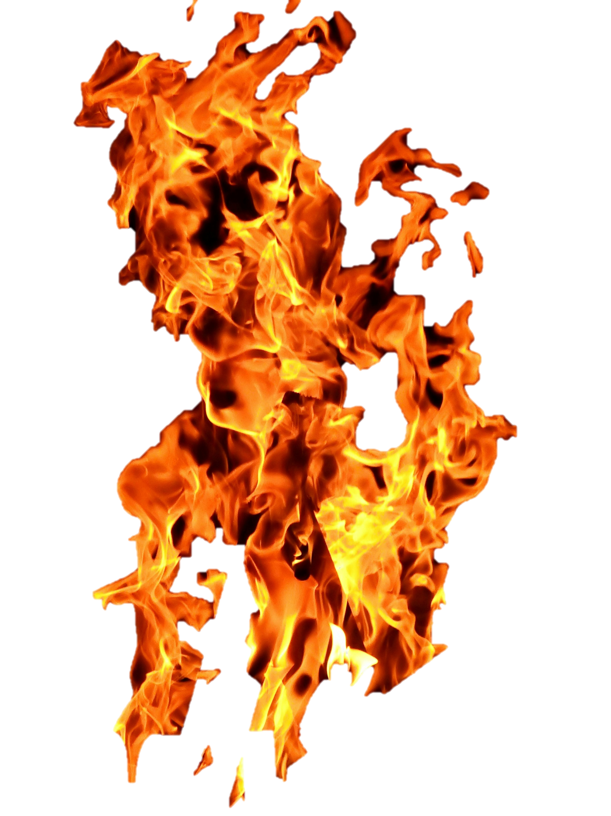
Methodology
01
Exploratory Data Analysis
02
Machine Learning
03
Fuzzy Inference System
04
Deep Learning

Slide 3



INTRODUCTION
Predicting flame extinction is important, needing models that are both accurate and easy to understand.
” Acoustic Extinguisher Fire Dataset” from Kaggle,
17.442 records and 6 features.
The target variable is binary, indicating whether the fire is extinguished
This project aims to compare different types of machine learning models, focusing on both performance and interpretability.

Slide 4
01
Exploratory Data Analysis

Slide 5
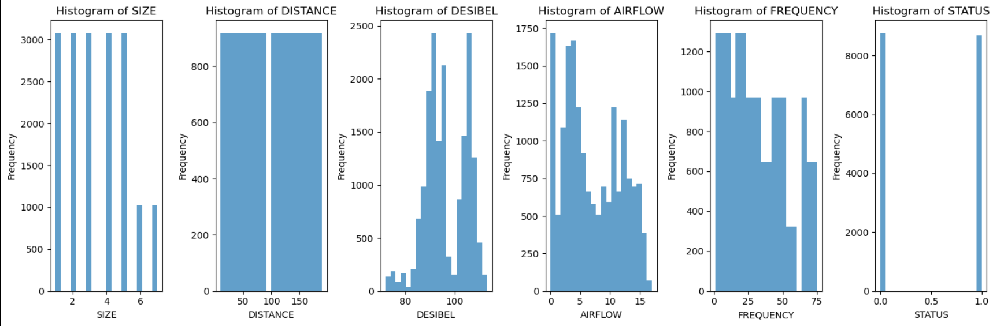
Exploratory Data Analysis

Slide 6
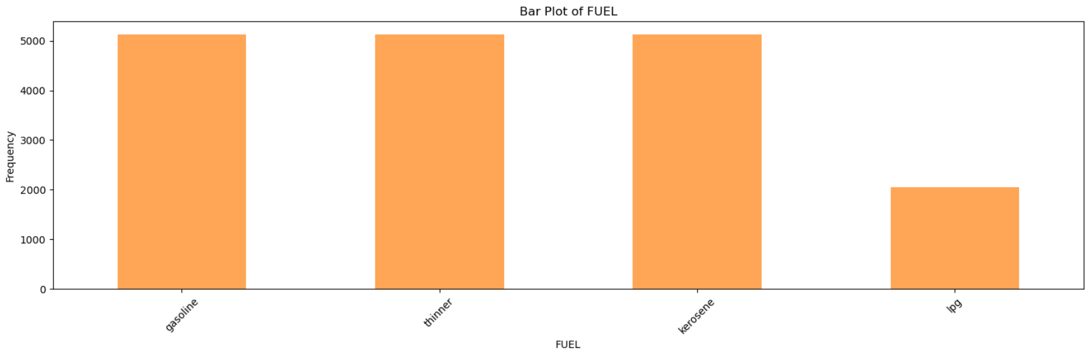
Exploratory Data Analysis

Slide 7
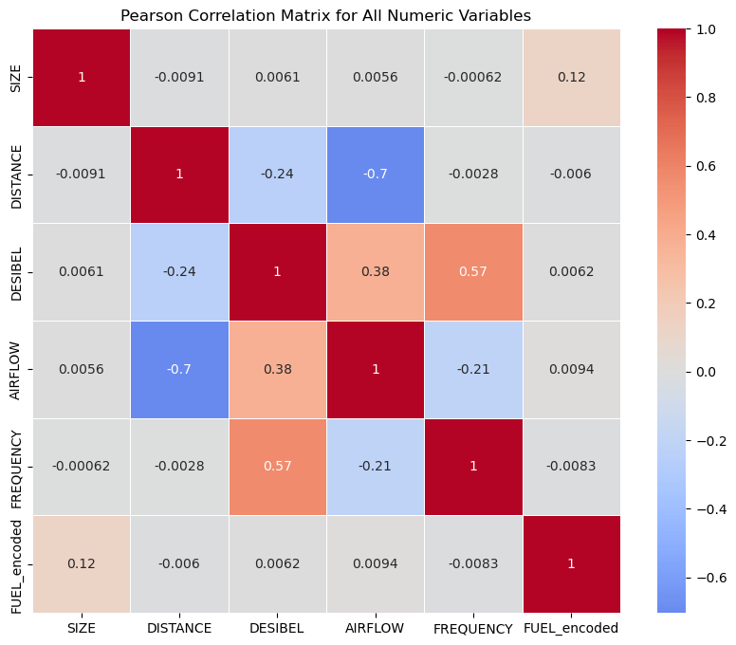
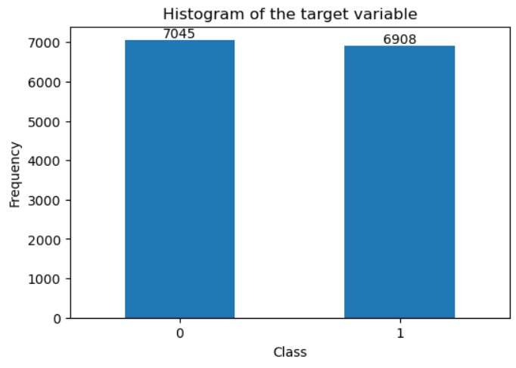
Feature Selection and Engineering
IQR used to identify and treat outliers;
Pearson correlation matrix used to identify correlated pairs of features;
The target variable wasn’t extremely unbalanced
RFE used to recursively identify relevant subsets of features;
Standard Scaler used to scale the data and adjust its distribution.t

Slide 8
02
Machine Learning

Slide 9



Different Methods
Logistic Regression
Random Forest Classifier
Support Vector Machine

Slide 10
Best results
Logistic Regression
"C": 0.1, "max_iter": 100, "penalty": "l1", "solver": "liblinear"
SVM
"C": 100, "degree": 2, "gamma": "scale", "kernel": "rbf"
RFC
"n_estimators": 100, "max_depth": None, "min_samples_leaf": 1, "min_samples_split": 5, "bootstrap": False

Slide 11
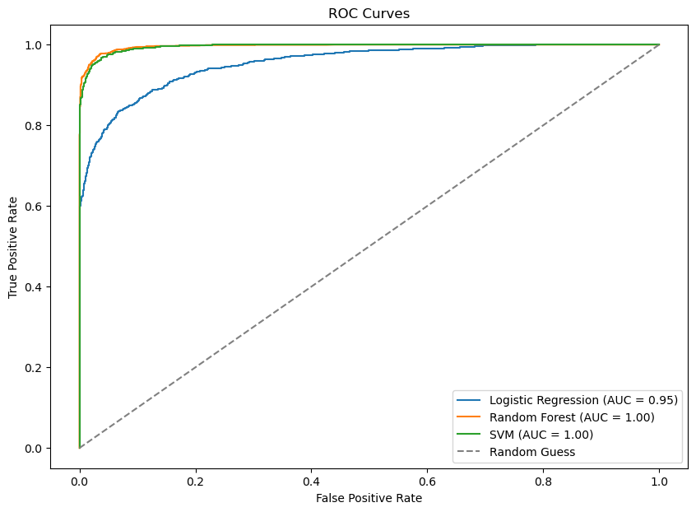
Results

Slide 12
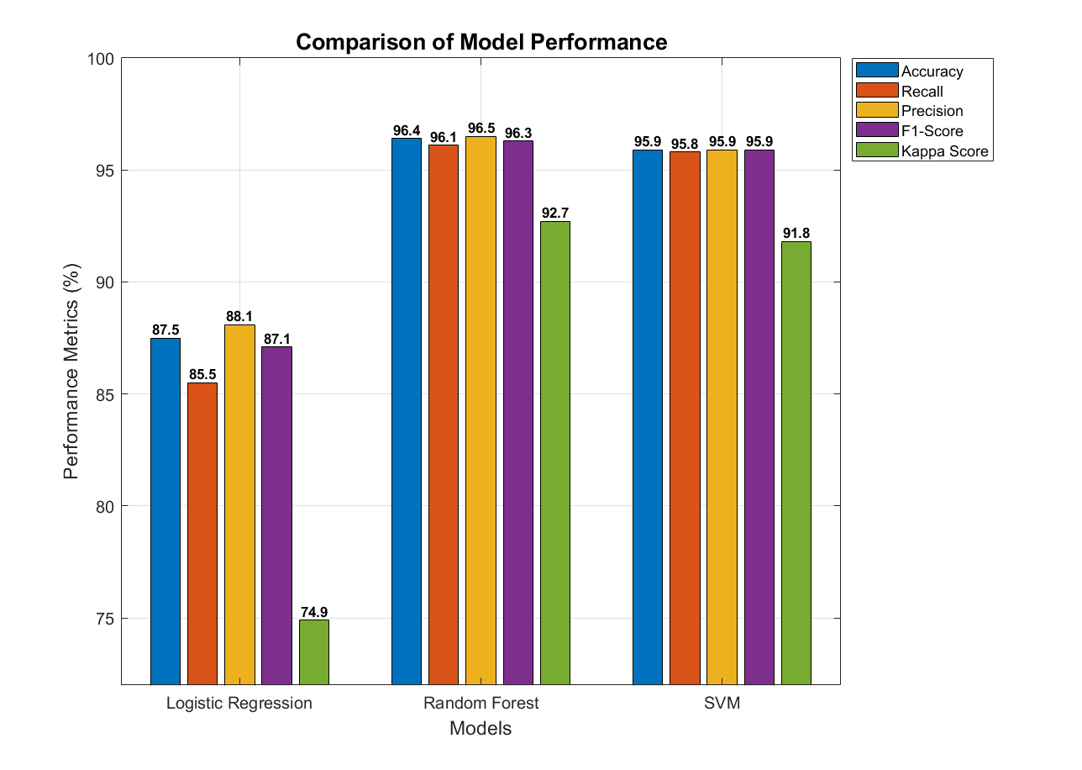
Results

Slide 13
03
Fuzzy Inference System

Slide 14
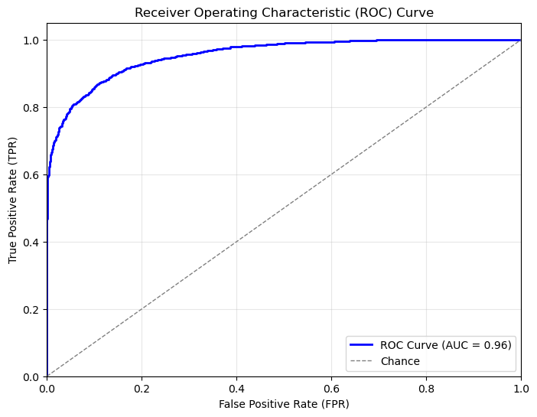
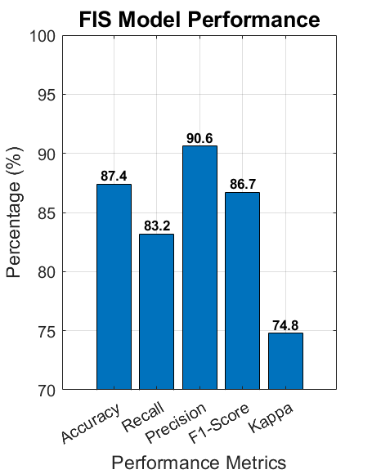
Best Results
Clustering_method: Gustafson-Kessel Num_clusters: 5

Slide 15
04
Deep Learning

Slide 16
Best Results
MPL
"hidden_layer_sizes": (100, 50), "activation": "tanh",
"solver": "adam",
"max_iter": 5000
DNN
"hidden_layers": [64, 128, 256], "activation": "relu",
"dropout_rate": 0.2,
"optimizer": "Adam",
"loss_function": "binary_crossentropy",
"epochs": 30

Slide 17
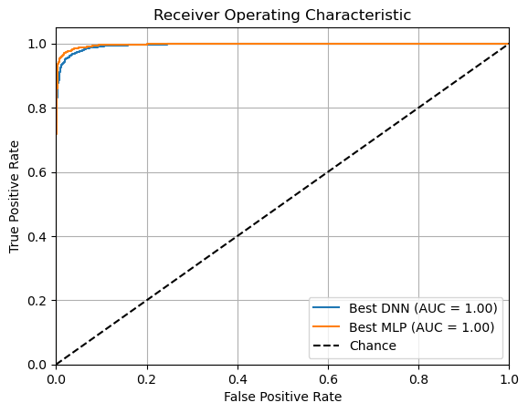
Best Results

Slide 18
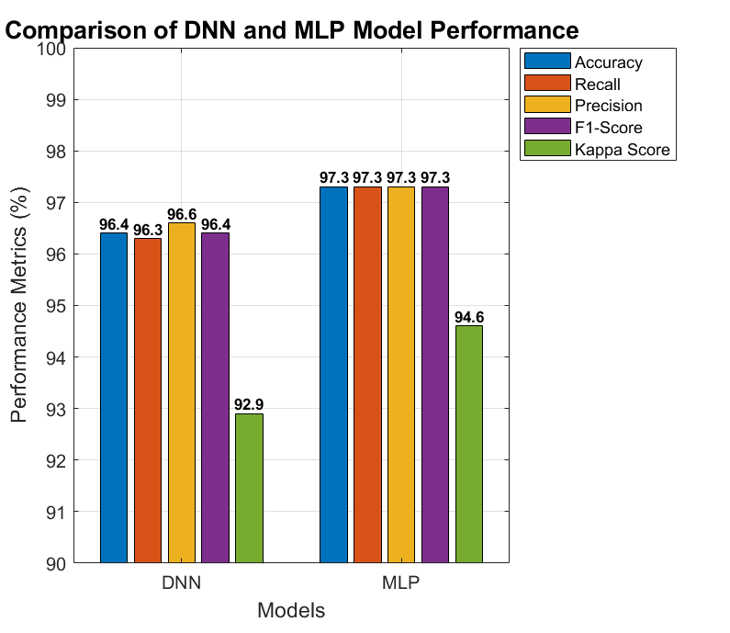
Best Results

Slide 19
04
Neuro Fuzzy System

Slide 20
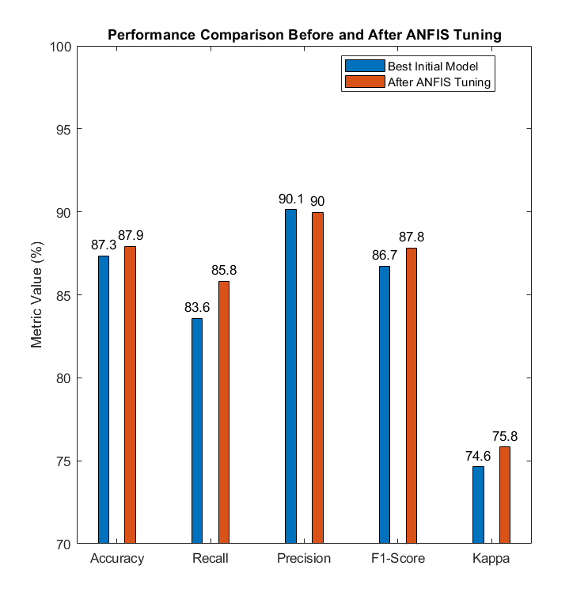
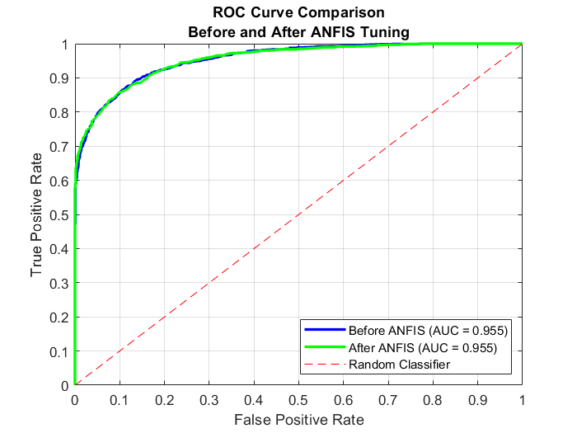
Model Construction
"num_clusters": 5,
"learning_rate": 0.05,
"epochs": 100

Slide 21
05
Final Results

Slide 22
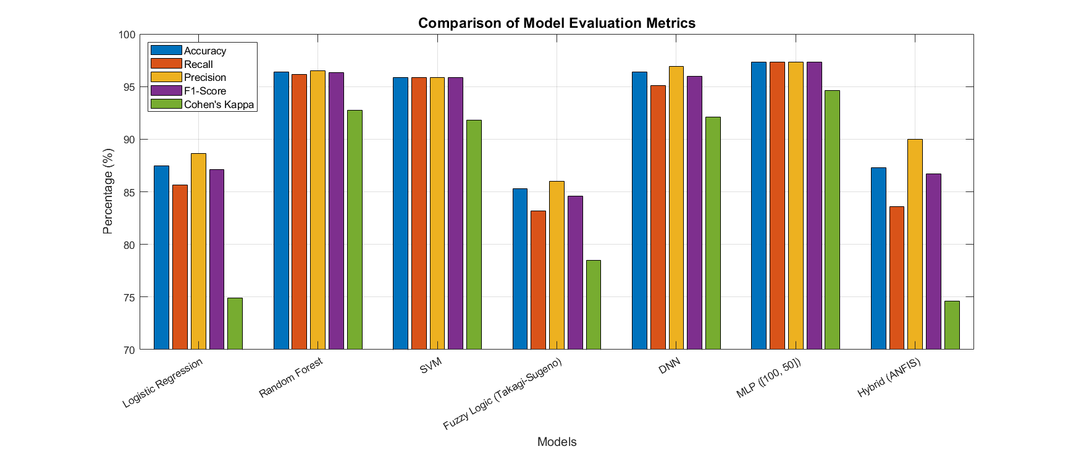
Results

Slide 23
Thank You

